Slide 1
Best Practices for Managing Escalated Behaviors
Facilitated by: Ron Gilson, Security Chief – Cedar Point

Slide 2
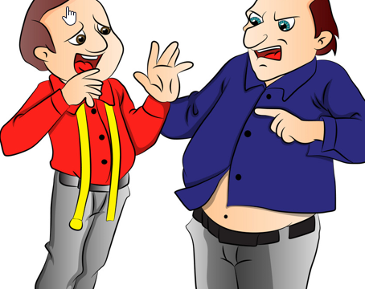
Types of aggressive behavior
Verbal
Physical
Psychological
Sexual Harassment/Assault
Workplace Violence

Slide 3
De-escalating Techniques
Be Open and Listen
Clarify what the issue is
Develop a resolution
Agree or compromise
Close
Managing Aggressive Behavior

Slide 4
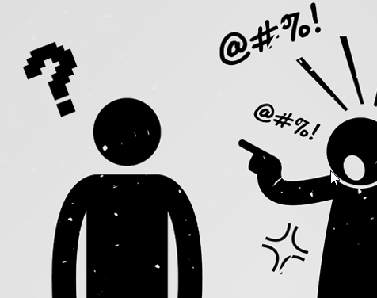
Managing Aggressive behavior
Each situation is going to be different
Personal safety
Safety of others
Remaining professional
Learn to reduce stress
Improving communication skills

Slide 5
Strategies for Preventing and Diffusing Aggressive Behavior
Prepare Yourself Mentally
1
Approach Individuals Properly
2
Communicate Effectively
3
Listen Effectively
4
Manage the Stages of Conflict
5

Slide 6
Prepare Yourself Mentally – The Purpose
Preparing mentally allows us to respond appropriately and automatically in various situations.
Enhance your learning and retention of new skills
Eliminate ineffective skills or habits
Control your stress level
Improve your decision making
Improve your confidence

Slide 7
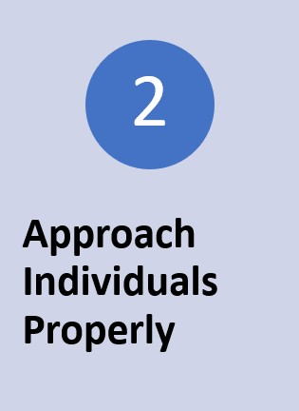
Approach Individuals Properly
Introduce yourself if needed
Have a co-worker assist to observe
Keep all persons in view
Have access to an Escape Route
Use a common office without distractions
If possible, confront only one person at a time

Slide 8
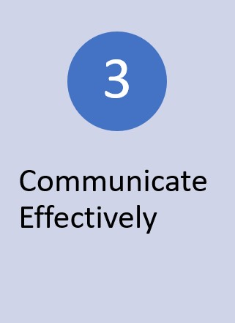
Communicate Effectively
Supportive Verbal Communication Skills
Maintain a calm reassuring voice
Communicate at their level
Speak with respect – but be in control
Use paralanguage – volume of speech, tone of voice, rate of speech
Ask them to repeat to clarify
Try using open ended questions
“How do you feel about this situation?”
I really understand how you feel…

Slide 9
Communicate Effectively – (Non-Verbally)
90% of all communication is non-verbal
Three Categories of Non-Verbal Communication
1. Personal Space and Reactionary Distance (3’)
2. Eye Communication
Maintain eye contact 60-70% of the time when you speak.
Maintain eye contact 90% of the time when the individual is speaking
Interpreting Eye Communications
Sizing you up (overpower you), Direct uninterrupted stare (dominance), Looking around (wanting to leave). Recognize Warning Signs
Gestures, Postures and facial Expressions
Signals coming from different parts of the body that reflect thoughts and feelings
Arms crossed, breathing, facial color, palms/hands, legs/stance

Slide 10
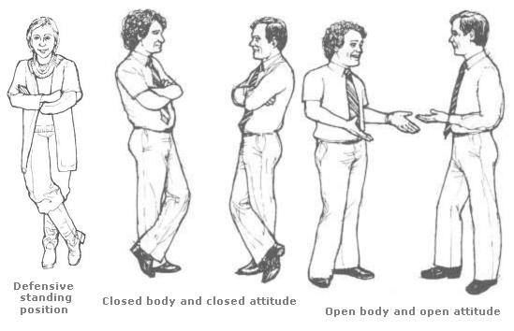
Communicate Non-Verbally
55% of Communication
Nonverbal (Body Language)
38% of Communication
Paraverbal (Tone, Volume)
7% of Communication
Actual words we use

Slide 11
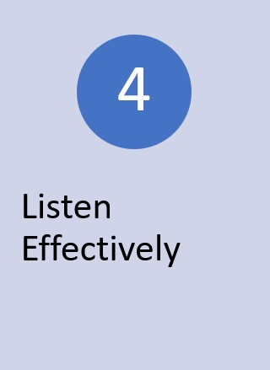
Listen Effectively
Most people listen with the intent to reply and do not listen with the intent to understand.
Listening involves having patience and openness, along with the desire to understand.
We only hear half of what is said, we listen to only half of that, and we remember only half of that

Slide 12
Listen Effectively
Levels of Listening
Ignoring another person – Not listening at all
Pretending to listen – Preoccupied with internal or external distractions
Selective listening – Listening, but only hearing parts of the conversation
Attentive listening – Listening to the words, but no listening to the feelings
Empathic listening – Listening with your ears, but more importantly, listening with your eyes and heart while paying attention to feelings and meaning

Slide 13
Manage the Stages of Conflict
Allow the individual to vent
1
Maintain eye communication
2
Use the individual's name
3
Maintain a calm voice
4
Notes:
Conflict Resolution and how to handle conflict in the moment

Slide 14
Questions?

